Slide 1

From C++ to C++11
Hoàng Mạnh Hưng: hung.hoangmanh2@gameloft.com
Phạm Quang Thiện: thien.pham@lge.com
May 2015

Slide 2
What is C++11?
Important changes
Getting started

Slide 3
What is C++11?
Important changes
Getting started

Slide 4
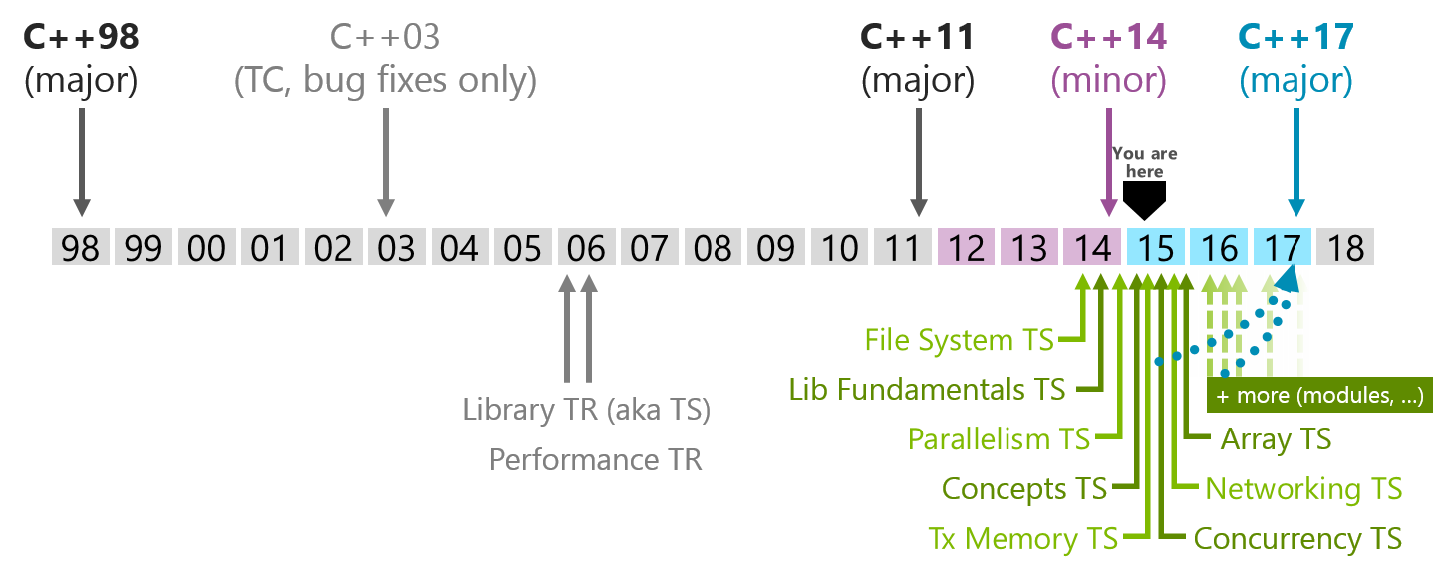
What is C++11?
ISO Standard approved on August 2011
Other name: C++0x
Notes:
C++ = C++98
Different between C++98 and C++03: not significant
TC: Technical Corrigendum
TR: Technical Report
TS: Technical Specification

Slide 5
What is C++11?
Important changes
Getting started

Slide 6
Important changes
auto variable
nullptr
Range-based for loops
decltype
Uniform Initialization & Initializer Lists
Override and final
Strongly-typed enums
Lambdas
Smart pointers
static_assert and type traits
Move semantics & rvalue reference
thread

Slide 7
auto variable
Earlier Version
int i = 42; long long l = 42LL; void(*p)(int, float, char) = foo; // void foo(int, float, char) vector<string>::iterator it = v.begin() // v has type vector<string>
Version11
auto i = 42; // i has type int auto l = 42LL; // l has type long long auto p = &foo; // p is pointer point to void foo function auto it = v.begin() // v has type vector<string> auto l = [](int x) -> bool { //l has the typeof a lambda ... // taking an int and returning a bool }; auto var; // ERROR: can’t deduce the type of var

Slide 8

nullptr
New keyword
Avoid implicit conversion to integral types
Has type std::nullptr_t
Example 1:
void foo(int* a)
{
std::cout << "int* \n";
}
void foo(int a)
{
std::cout << "int\n";
}
int main()
{
foo(NULL);
return 0;
}

Slide 9

Nullptr (CONT.)
Example 2:
#ifdef NULL
#undef NULL
#define NULL 0
#endif
#ifdef nullptr
#undef nullptr
#define nullptr 1
#endif
int main()
{
Int*a =0;
printf("%d, %d\n", NULL, nullptr);
return 0;
}

Slide 10
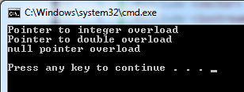
Nullptr (CONT.)
Example 3:
void f(int* pi) {
std::cout << "Pointer to integer overload\n";
}
void f(double* pd) {
std::cout << "Pointer to double overload\n";
}
void f(std::nullptr_t nullp) {
std::cout << "null pointer overload\n";
}
int main() {
int* pi = NULL; double* pd = nullptr;
f(pi);
f(pd);
f(nullptr); // would be ambiguous without void f(nullptr_t)
//f(NULL); // ambiguous overload: all three functions are candidates
return 0;
}

Slide 11
Range-based for loops
So-called “foreach” loop.
Example 1:
for (auto i : { 1,2,3,4,5 })
{
std::cout << i << std::endl;
}
Example 2:
int arr[] = { 1,2,3,4,5 };
for (int& e : arr)
{
e = e * e;
}

Slide 12
Range-based for loops (cont.)
Example 3:
std::vector<int> v = { 0, 1, 2, 3, 4, 5 };
for (auto it = v.begin(); it != v.end(); it++)
{
std::cout << *it << ' ';
}
New: Non-member begin() and end()
Example 4:
for (auto it = std::begin(v); it != std::end(v); it++)
{
std::cout << *it << ' ';
}
Notes:
Non-member begin() and end() are a new addition to the standard library. They work with all STL containers, C-like array and they are overloadable

Slide 13
decltype
Get type of an expression
Can be used in definition
Example 1:
int main() {
typedef short int8_t;
int8_t d = 2;
int x = 5;
const int cx = 47;
const int& crx = x;
typedef decltype(x) x_type;// x is declared as an int: x_type is int.
auto a = x;// auto also deduces the type as int: a is an int.
typedef decltype(cx) cx_type;// cx is declared as const int: cx_type is const int.
auto b = cx;// auto drops the const qualifier: b is int.
typedef decltype(crx) crx_type;// crx is declared as const int&: crx_type is const int&.
auto c = crx;// auto drops the reference and the const qualifier: c is an int.
return 0;
}
Notes:
This notion has been popular in generic programming under the label "typeof" for a long time, but the typeof implementations in actual use were incomplete and incompatible, so the standard version is named decltype.

Slide 14
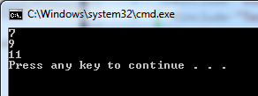
DECLTYPE (CONT.)
Example 2:
void f(const std::vector<int>& a, std::vector<float>& b)
{
typedef decltype(a[0] * b[0]) Tmp;
for (int i = 0; i < b.size(); ++i)
{
Tmp* p = new Tmp(a[i] + b[i]);
std::cout << *p << "\n";
}
}
int main() {
std::vector<int> v1 = { 0, 1, 2, 3, 4, 5 };
std::vector<float> v2 = { 7.0f, 8.0f, 9.0f};
f(v1, v2);
}

Slide 15
Uniform Initialization & Initializer Lists
Initializer lists are not just for arrays
C++11 allows {}-initializer lists for all initialization
C++11 supports in-class initialization
E.g.
std::list<double> v = { 1.5, 2, 3.456, 99.99 };
std::vector<std::string> cities{ "Hanoi", "London" };
int j{}; // j is initialized by 0
int* q{}; // q is initialized by nullptr
Notes:
C++ provides many ways for initialization, making confusions
C++11 offers uniform brace notation for all initialization

Slide 16
Uniform Initialization & Initializer Lists (cont.)
class C
{
int a;
int b;
int arr[4];
public:
C() : arr{ 1,2,3,4 } {} //C++11, member array initializer
C(int i, int j) : a(i), b(j) {}
};
void main()
{
C c{ 0,0 }; //C++11 only. Equivalent to: C c(0,0);
int* a = new int[3]{ 1, 2, 0 }; // C++11 only
}

Slide 17
Uniform Initialization & Initializer Lists (cont.)
Prevent narrowing:
int x1 (5.3); // OK, but x1 becomes 5
int x2 = 5.3; // OK, but x2 becomes 5
int x3 { 5 }; // OK
int x4 { 5.0 }; // ERROR: narrowing
int x5 = { 5.3 }; // ERROR: narrowing
char c1 { 7 }; // OK: even though 7 is an int, this is not narrowing
char c2 { 99999 }; // ERROR: narrowing (if 99999 doesn’t fit into a char)
std::vector<int> v1{ 1, 2, 4, 5 }; // OK
std::vector<int> v2{ 1, 2.3, 4, 5.6 }; // ERROR: narrowing doubles to ints
Notes:
For reference, see 8.5.4/6 of n3225
A narrowing conversion is an implicit conversion:
- from a floating-point type to an integer type, or
- from long double to double or float, or from double to float, except where the source is a constant expression and the actual value after conversion is within the range of values that can be represented (even if it cannot be represented exactly), or
- from an integer type or unscoped enumeration type to a ﬂoating-point type, except where the source is a constant expression and the actual value after conversion will fit into the target type and will produce the original value when converted back to the original type, or
- from an integer type or unscoped enumeration type to an integer type that cannot represent all the values of the original type, except where the source is a constant expression and the actual value after conversion will fit into the target type and will produce the original value when converted back to the original type.

Slide 18
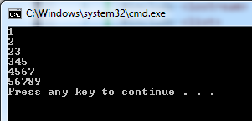
Uniform Initialization & Initializer Lists (cont.)
void f (std::initializer_list<int> args)
{
for (auto p = args.begin(); p != args.end(); ++p)
std::cout << *p << "\n";
}
void main()
{
f({ 1,2 });
f({ 23,345,4567,56789 });
f({}); // the empty list
//f{ 1,2 }; // error: function call ( ) missing
}

Slide 19

Override and final
Example: Class D wants to override f() from class B
class B
{
public:
virtual void f(short)
{
std::cout << "B::f" << std::endl;
}
};
class D : public B
{
public:
virtual void f(int)
{
std::cout << "D::f" << std::endl;
}
};
class B
{
public:
virtual void f(int) const
{
std::cout << "B::f" << std::endl;
}
};
class D : public B
{
public:
virtual void f(int)
{
std::cout << "D::f" << std::endl;
}
};
void main()
{
B* b1 = new D;
b1->f(5);
}
Notes:
These are overloads, not overrides

Slide 20
Override and final (cont.)
Solution:
class B
{
public:
virtual void f(int) { std::cout << "B::f" << std::endl; }
};
class D : public B
{
public:
virtual void f(int) override final { std::cout << "D::f" << std::endl; }
};
class F : public D
{
public:
virtual void f(int) override { std::cout << "F::f" << std::endl; }
};
Error
Notes:
Use overload to let compiler know you intend to overload from base class
Use final to prevent derive class from overloading your function
The override keyword serves two purposes:
- It shows the reader of the code that "this is a virtual method, that is overriding a virtual method of the base class."
- The compiler also knows that it's an override, so it can "check" that you are not altering/adding new methods that you think are overrides.

Slide 21


Strongly-typed enums
C++ | C++11
E.g. - Value: int | E.g. - Value: any signed / unsigned integral type (default: int)
Error

Slide 22
Lambdas
Examples:
auto f = []()->int{
return 10;
};
std::cout << "Return value: " << f() << std::endl;
int arr[]{ 1, 9, 8, 3, 4, 8, 6 };
int totalNumber = 0;
int a = 5;
for (auto n : arr)
{
[&, a](int x) {
if (x > a)
totalNumber++;
}(n);
}
std::cout << "Total number greater than 5: " << totalNumber << std::endl;
auto f = [&, a](int x){
if (x > a)
totalNumber++;
};
f(n);

Slide 23
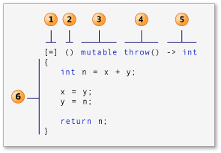
Lambdas (CONT.)
Capture clause (Also known as the lambda-introducer in the C++ specification.)
[a,&b] a captured by value, b captured by reference
[this] captures the this pointer by value
[&] captures all automatic variables in the body of the lambda by reference
[=] captures all automatic variables in the body of the lambda by value
[] captures nothing
Parameter list Optional. (lambda declarator)
Mutable specification Optional.
Exception-specification Optional.
Trailing-return-type Optional.
Lambda body

Slide 24
Smart pointers
Required header: <memory>
auto_ptr
shared_ptr
weak_ptr
unique_ptr

Slide 25
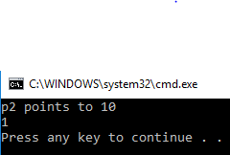
auto_ptr
int main()
{
std::auto_ptr<int> p1(new int);
*p1.get() = 10;
std::auto_ptr<int> p2(p1);
std::cout << "p2 points to " << *p2 << '\n'
<< (p1.get() == nullptr) << '\n';
// (p1 is now null-pointer auto_ptr)
return 0;
}
How about std::auto_ptr<Manager> p3(new Manager[2]);

Slide 26



Normal pointers problem
class A
{
private:
int x;
public:
virtual ~A() { std::cout << "~A"; }
void SetX() { x = 10; }
void GetX() { std::cout << x << std::endl; }
};
void main()
{
A* p1 = new A();
{
A* p2 = p1;
p2->SetX();
delete(p2);
}
p1->GetX();
}
Stack
Heap
p1
p2
Who will care release memory ?
Notes:
P1 is call dangling pointer

Slide 27
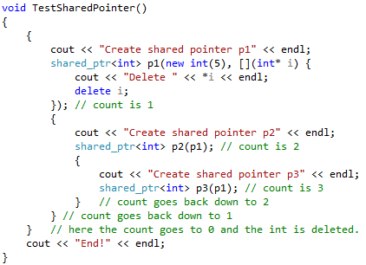
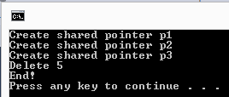
shared_ptr
Represent shared ownership of some data
Is an automatic reference counter
Allows user-defined deleter
Notes:
A shared_ptr is used to represent shared ownership; that is, when two pieces of code needs access to some data but neither has exclusive ownership (in the sense of being responsible for destroying the object). A shared_ptr is a kind of counted pointer where the object pointed to is deleted when the use count goes to zero.

Slide 28
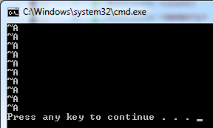

shared_ptr (cont.)
Problems with arrays: shared_ptr automatic called delete instead of delete[] when releasing memory
Solution:
Use user-defined deleter
Use default_delete:
shared_ptr<MyClass> p(new MyClass[10], default_delete<MyClass[]>());
Note: Do not create shared_ptr of array type
std::unique_ptr<int[]> p1(new int[10]); //OK
std::shared_ptr<int[]> p2(new int[10]); //ERROR: does not compile

Slide 29
shared_ptr (cont.)
Misuse of shared-ptr:
int *p = new int(10);
std::shared_ptr<int> sp1(p);
std::shared_ptr<int> sp2(p);
Solution:
std::shared_ptr<int> sp1(new int(10));
// or better:
std::shared_ptr<int> sp1 = std::make_shared<int>(10);
std::shared_ptr<int> sp2(sp1);
Compile OK, but runtime error
Notes:
Error: 2 shared pointers manage allocated int

Slide 30
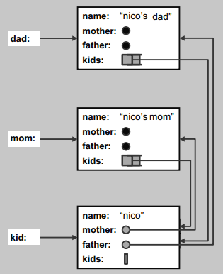
shared_ptr (cont.) - problem
Example:
Person
+ name (string) + mother (Person) + father (Person) + kids (vector<Person)

Slide 31

shared_ptr problem (cont.)
Example:
class Person
{
public:
string name;
shared_ptr<Person> mother;
shared_ptr<Person> father;
vector<shared_ptr<Person>> kids;
Person(const string& n,
shared_ptr<Person> m = nullptr,
shared_ptr<Person> f = nullptr)
: name(n), mother(m), father(f) {}
virtual ~Person() {
cout << "Delete " <<
name.c_str() << "\n";
}
};
shared_ptr<Person> InitFamily(const string& name)
{
shared_ptr<Person> mom(new Person(name + "'s mom"));
shared_ptr<Person> dad(new Person(name + "'s dad"));
shared_ptr<Person> kid(new Person(name, mom, dad));
mom->kids.push_back(kid);
dad->kids.push_back(kid);
return kid;
}
void main()
{
std::shared_ptr<Person> p = InitFamily("nico");
}
Shared pointers never release

Slide 32
weak_ptr
Holds a reference to an object managed by a shared_ptr
Does not contribute to the reference count
Used to break dependency cycles

Slide 33
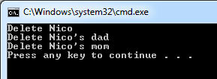
weak_ptr (cont.)
Solution:
class Person
{
public:
string name;
shared_ptr<Person> mother;
shared_ptr<Person> father;
vector<weak_ptr<Person>> kids;
Person(const string& n,
shared_ptr<Person> m = nullptr,
shared_ptr<Person> f = nullptr)
: name(n), mother(m), father(f) {}
virtual ~Person() { cout << "Delete " << name.c_str() << "\n";}
};
Different access:
p->mother->kids[0]->name // for shared_ptr
p->mother->kids[0].lock()->name // for weak_ptr

Slide 34
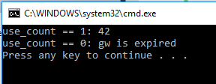
weak_ptr (cont.)
Example 2:
std::weak_ptr<int> gw;
void f()
{
std::cout << "use_count == " << gw.use_count() << ": ";
if (!gw.expired()) {
auto spt = gw.lock(); // Must copied into a shared_ptr before usage
std::cout << *spt << "\n";
}
else
std::cout << "gw is expired\n";
}
int main()
{
{
auto sp = std::make_shared<int>(42);
gw = sp;
f();
}
f();
}
Notes:
it allows you to locate an object if it's still around, but doesn't keep it around if nothing else needs it.

Slide 35
unique_ptr
Provides strict ownership
Is not CopyConstructible / CopyAssignable
Is MoveConstructible / MoveAssignable
Usage:
Providing exception safety
Passing ownership to a function
Returning ownership from a function
Storing pointers in containers
Notes:
Because there can only be one unique_ptr to any resource, any attempt to make a copy of a unique_ptr will cause a compile-time error.

Slide 36

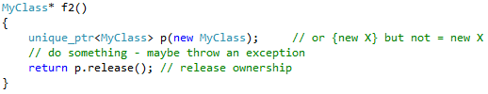
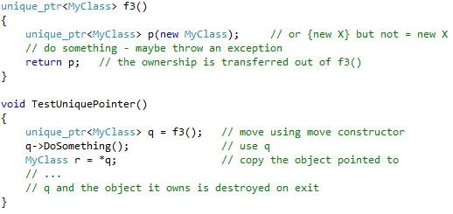
unique_ptr (cont.)
Example:
Solution:
Or:
Exception unsafe

Slide 37
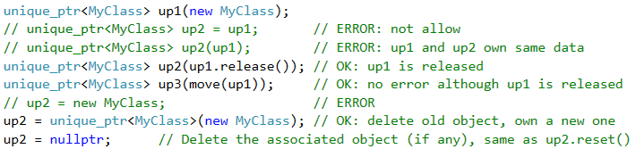
unique_ptr (cont.)
Allocate and release:
Dealing with arrays:

Slide 38
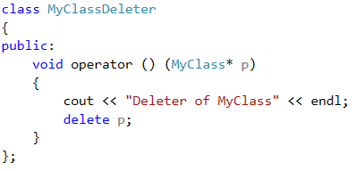
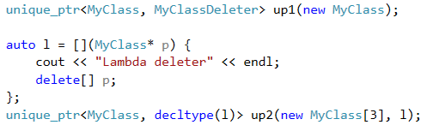
unique_ptr (cont.)
Using deleter:

Slide 39
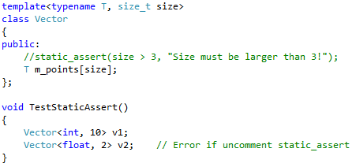
static_assert and type traits
static_assert performs an assertion check at compile-time
static_assert(2 + 2 == 4, "2+2 isn't 4"); // well-formed
static_assert(sizeof(int) < sizeof(char),
"this program requires that int is less than char"); // compile-time error

Slide 40
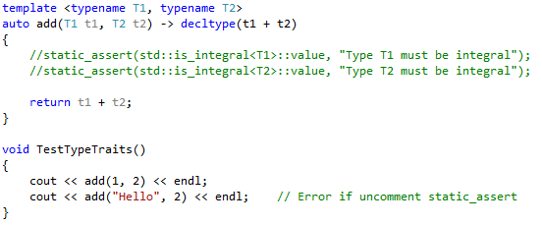
static_assert and type traits (cont.)
<type_traits> defines a series of classes to obtain type information on compile-time: is_integer, is_pointer, is_void, etc.
Helper classes
Type traits
Type transformations

Slide 41
static_assert and type traits (cont.)
Example 2:
template <typename T>
struct is_swapable {
static const bool value = false;
};
template <>
struct is_swapable<short> {
static const bool value = true;
};
template <>
struct is_swapable<long> {
static const bool value = true;
};
void main()
{
assert(is_swapable<int>::value && "Cannot swap this type");// runtime error
static_assert(is_swapable<int>::value, "Cannot swap this type");// compile error
}
Notes:
http://blog.aaronballman.com/2011/11/a-simple-introduction-to-type-traits/
http://www.bogotobogo.com/cplusplus/template_specialization_traits.php

Slide 42
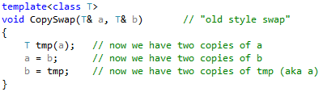
Move semantics & rvalue reference
Example:
It may be expensive to copy T
We only want to “move” the values around

Slide 43
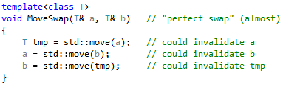
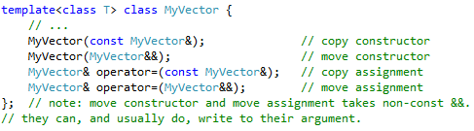
Move semantics & rvalue reference (cont.)
Solution:
“move constructors” and “move assignments”:

Slide 44
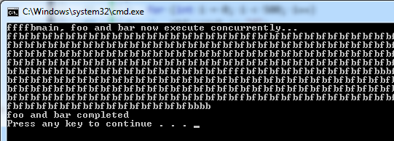
thread
Allow multiple pieces of code to run asynchronously and simultaneously.
void foo() {
for (int i = 0; i < 500; i++)
std::cout << "f";
}
void bar(int x) {
for (int i = 0; i < 500; i++)
std::cout << "b";
}
void main()
{
std::thread first(foo);// spawn new thread that calls foo()
std::thread second(bar, 5);// spawn new thread that calls bar(5)
std::cout << "main, foo and bar now execute concurrently...\n";
// synchronize threads
first.join();// pause until first finishes
second.join();// pause until second finishes
std::cout << "\nfoo and bar completed\n";
}

Slide 45
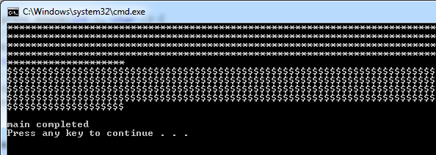
thread - mutex
std::mutex protect shared data from being simultaneously accessed by multiple threads.
std::mutex mtx;// mutex for critical section
void print_block(int n, char c) {
// critical section (exclusive access to std::cout signaled by locking mtx)
mtx.lock();
for (int i = 0; i < n; ++i)
std::cout << c;
std::cout << '\n';
mtx.unlock();
}
void main()
{
std::thread th1(print_block, 500, '*');
std::thread th2(print_block, 500, '$');
th1.join();
th2.join();
std::cout << "\nmain completed\n";
}

Slide 46
thread – mutex (cont.)
void print_block(int n, char c) {
// critical section (exclusive access to std::cout signaled by locking mtx)
std::lock_guard<std::mutex> guard(mtx);
for (int i = 0; i < n; ++i)
std::cout << c;
std::cout << '\n';
}

Slide 47
thread - atomic
std::atomic prevents data races between threads.
Data
Thread 1
Thread 2
Write
Read

Slide 48


thread - atomic (cont.)
void dot_product(const std::vector<int> &v1, const std::vector<int> &v2, int& result, int begin, int end)
{
for (int i = begin; i < end; ++i)
{
result += (v1[i] * v2[i]);
}
}
void TestAtomic()
{
int nElements = 10000, nThreads = 2;
int result = 0;
std::vector<std::thread> threads;
std::vector<int> v1(nElements, 1), v2(nElements, 2);
// Split nElements into nThreads parts
std::vector<int> limits;
for (int i = 0; i <= nElements; i += nElements / nThreads)
limits.push_back(i);
// Launch nThreads threads
for (int i = 0; i < nThreads; i++)
threads.push_back(std::thread(dot_product, std::ref(v1), std::ref(v2), std::ref(result), limits[i], limits[i + 1]));
for (auto &t : threads)
t.join();
std::cout << result << std::endl;
}
void main()
{
TestAtomic();
}

Slide 49

thread - atomic (cont.)
Solution:
#include <atomic>

Slide 50
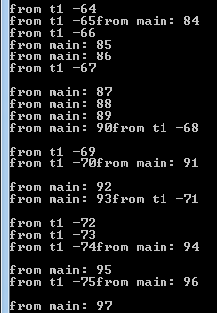
Example 2:
void function1() {
for (int i = 0; i > -100; --i) {
std::cout << "from t1 " << i << std::endl;
//printf("from t1: %d\n", i);
}
}
void main()
{
std::thread t1(function1);
for (int i = 0; i < 100; ++i) {
std::cout << "from main: " << i << std::endl;
//printf("from main: %d\n", i);
}
t1.join();
}
Notes:
https://stackoverflow.com/questions/307612
https://www.youtube.com/watch?v=3ZxZPeXPaM4&list=PL5jc9xFGsL8E12so1wlMS0r0hTQoJL74M&index=325/how-to-use-stdatomic

Slide 51
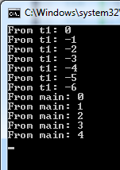
thread - deadlock
std::mutex _mu;// mutex for critical section
std::mutex _mu2;// mutex for critical section
void sharePrint(string id, int value) {
std::lock_guard<mutex> locker(_mu);
std::lock_guard<mutex> locker2(_mu2);
std::cout << "From " << id.c_str() << ": " << value << std::endl;
}
void sharePrint2(string id, int value) {
std::lock_guard<mutex> locker2(_mu2);
std::lock_guard<mutex> locker(_mu);
std::cout << "From " << id.c_str() << ": " << value << std::endl;
}
void function1() {
for (int i = 0; i > -100; --i) {
sharePrint("t1", i);
}
}
void main()
{
std::thread t1(function1);
for (int i = 0; i < 100; ++i) {
sharePrint2("main", i);
}
t1.join();
}
Notes:
https://www.youtube.com/watch?v=_N0B5ua7oN8&list=PL5jc9xFGsL8E12so1wlMS0r0hTQoJL74M

Slide 52
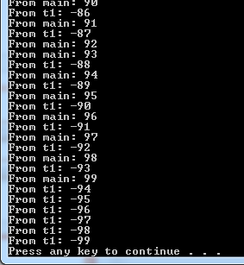
thread - deadlock
Solution:
void sharePrint(string id, int value)
{
std::lock(_mu, _mu2);
std::lock_guard<mutex> locker(_mu, std::adopt_lock);
std::lock_guard<mutex> locker2(_mu2, std::adopt_lock);
std::cout << "From " << id.c_str() << ": " << value << std::endl;
}
void sharePrint2(string id, int value)
{
std::lock(_mu, _mu2);
std::lock_guard<mutex> locker2(_mu2, std::adopt_lock);
std::lock_guard<mutex> locker(_mu, std::adopt_lock);
std::cout << "From " << id.c_str() << ": " << value << std::endl;
}

Slide 53
Avoiding deadlock
https://www.youtube.com/watch?v=_N0B5ua7oN8&list=PL5jc9xFGsL8E12so1wlMS0r0hTQoJL74M&index=4

Slide 54
What is C++11?
Important changes
Getting started

Slide 55
Getting started
Compilers:
Visual Studio
Notes:
http://en.cppreference.com/w/cpp/compiler_support

Slide 56
Visual Studio
VS 2012 Express with November 2012 Compiler CTP or later
Some features may not available yet
Visual studio 2017 Community is good enough.
Notes:
November 2012 Compiler CTP: http://aka.ms/vc-ctp

Slide 57
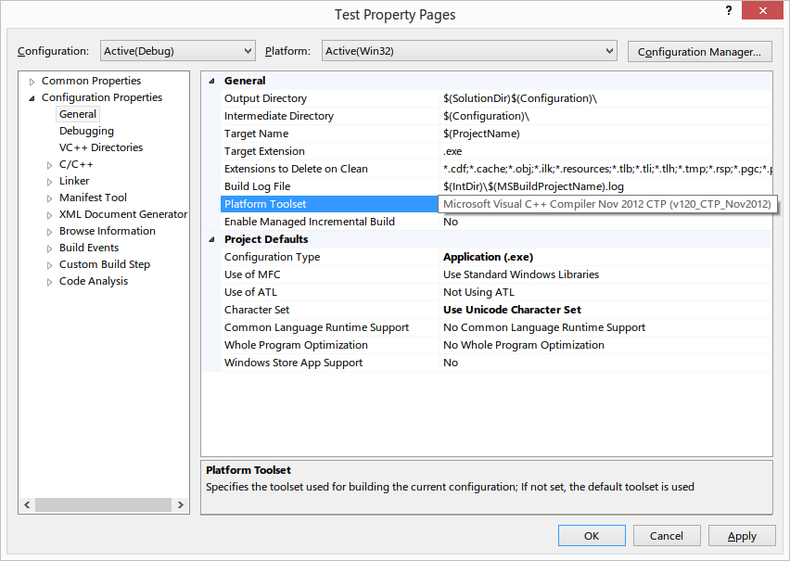
Visual Studio (cont.)

Slide 58
Try it online
Coding Ground
C++ Shell
Notes:
Coding Ground: http://www.tutorialspoint.com/codingground.htm
C++ Shell: http://cpp.sh

Slide 59
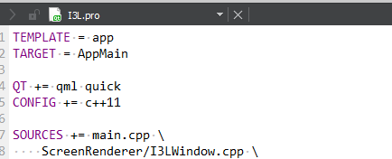
In I3L projects?
Add to CONFIG in I3L.pro:

Slide 60
References
http://www.stroustrup.com/C++11FAQ.html
http://www.codeproject.com/Articles/570638/Ten-Cplusplus-Features-Every-Cplusplus-Developer

Slide 61



